Slide 1
E-commerce clickstream analysis
Enhancing Conversion Rates Through User Behaviour Insights
A data driven project in PowerBi
Jonemoni Kalita

Slide 2
Problem Statement
The ecommerce platform lacks visibility into how users interact with the site, what influences purchases and where drop-offs occur.
Without this understanding , marketing efforts, UX decisions and product placement are driven by assumptions rather than data.
This project aims to address that gap using clickstream analysis.

Slide 3
Project Objective
Analyzed and visualized 10,000 rows of clickstream data to understand user engagement, traffic performance, and sales trends. The goal is to uncover actionable insights that improve user experience, marketing strategy, and business outcomes.

Slide 4
Dataset Overview
Size: 10,000 sessions
Columns: 26 features including session ID, duration, page views, product category, price, action taken, device type, traffic source, geography, revenue, and conversion.

Slide 5
Tools Used
Data Visualization: Power BI
Data Transformation: Power Query
Calculated Fields: Measures (AOV, conversion rate, session duration buckets)

Slide 6
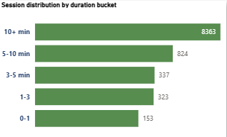
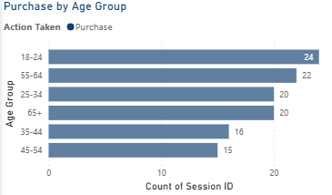
Key Insights: User Behavior
Longer sessions (10+ mins) accounted for ~80% of total sessions and had higher conversion.
Age group 45–54 showed the highest purchase rate, while 35–44 had the lowest.
Gender-wise sessions were balanced across Male, Female, and Other.
Electronics is the most viewed product category and generated highest revenue; some blank product category values exist and should be cleaned.

Slide 7
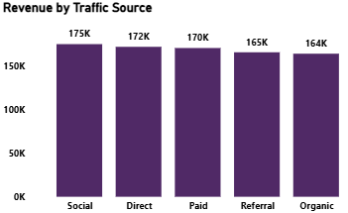
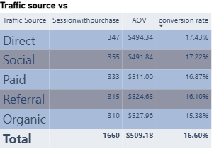
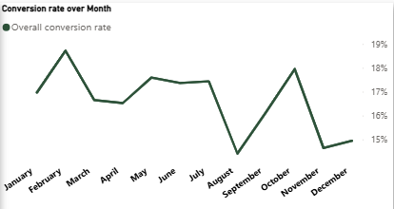
Key Insights : Marketing Performance
Direct traffic source had the highest conversion rate (17.43%).
Organic traffic showed the highest AOV ($527) but the lowest conversion rate.
Social traffic brought the most sessions and the highest total revenue.
Conversions peaked in February and October, while August was the weakest month.

Slide 8
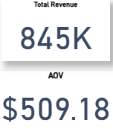
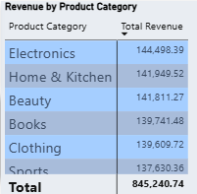
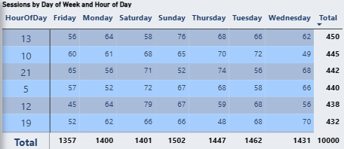
Key Insights : Sales & Time Trends
Total Revenue: $845,000
Average Order Value: $509
Top revenue came from a few high-value customers (e.g., Customer ID C0464).
Electronics generated highest revenue.
Engagement was highest during specific weekdays and noons, useful for campaign timing.

Slide 9
Final Insights
80% of sessions lasted 10+ minutes , longer session drive more conversion.
Age group 45-54 accounts for the highest purchases.
Electronics has the highest page views and revenue.
Organic traffic brings high order value but lower conversion.
February has the highest engagement across all actions and August shows the weakest engagement.

Slide 10
Recommendations
Focus more on Direct and Social traffic channels as they brought in the most purchases and revenue.
Run marketing campaigns targeted at users aged 45–54 and those with longer session times, since they buy more.
Fix missing product category data to get clearer results in future analysis.
Start using Customer ID and Product ID columns for more detailed user and product-level insights.
Use hourly user activity patterns (like peak evening hours) to time ads and campaigns better

Slide 11
Conclusion
This e-commerce clickstream analysis uncovered key behavioural patterns, such as high conversions during longer sessions, strong performance from the 45–54 age group, and significant revenue from electronics and social traffic. The insights derived can directly inform user experience optimization, targeted marketing, and campaign planning. Overall, this project demonstrates the ability to turn raw session data into strategic business insights.

